Slide 1


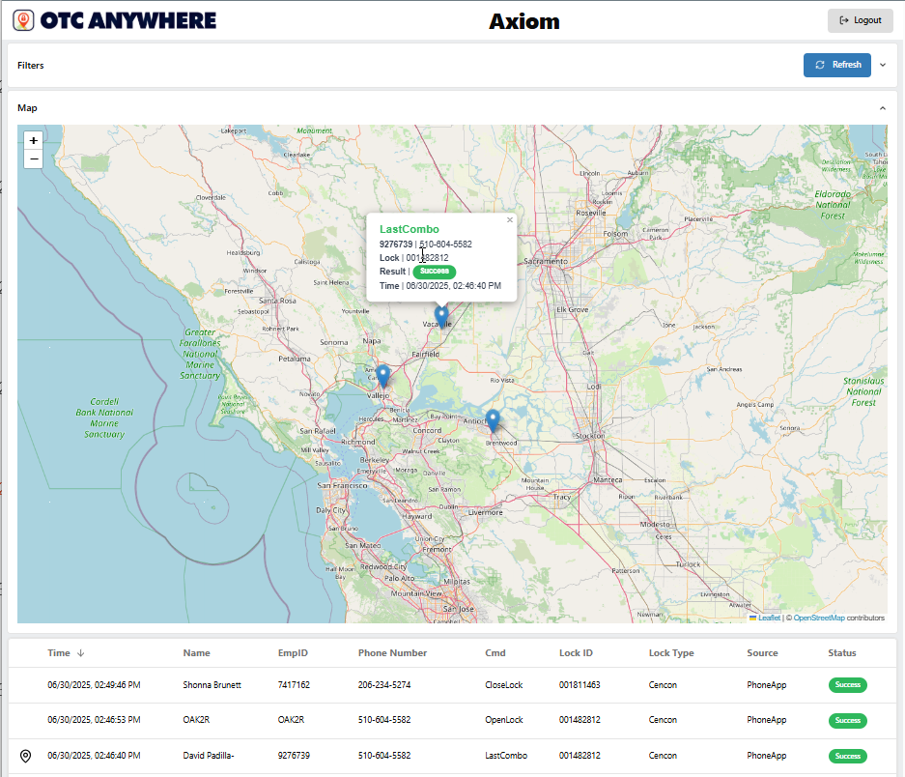
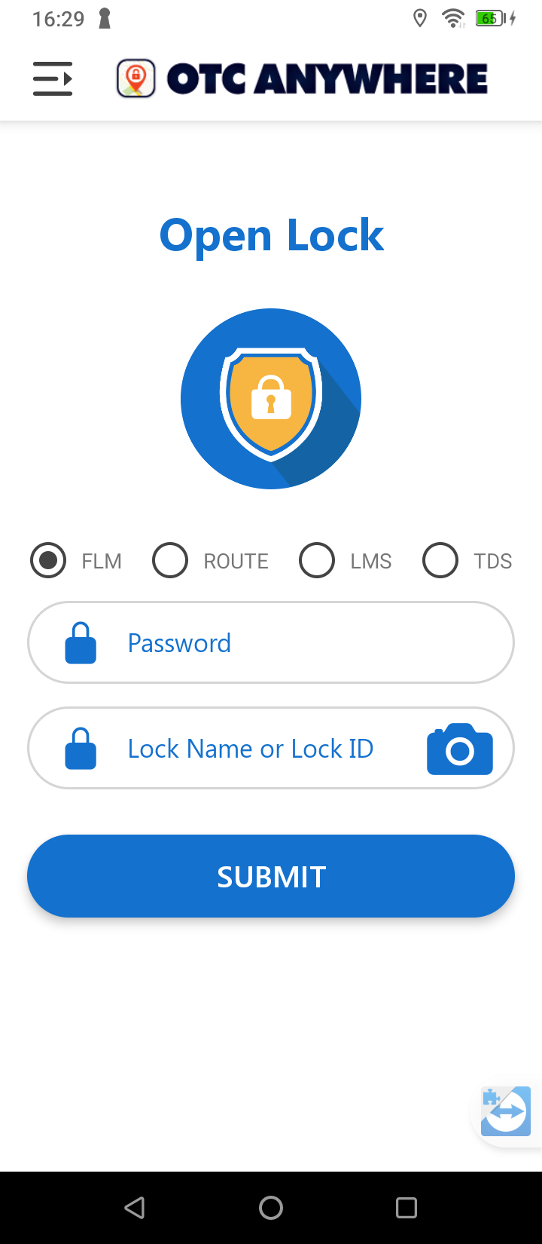

Platform | Lock Hosting | Deployments | Benefits | On Ramp
Always Available | Automated Lock Operations
Sales
Support
Admin
Dashboard
{https://dashboard.otcanywhere.com/login}
{https://restnova.coorworks.com/cgi-bin/atm.cgi}
Automated ATM Lock Dispatching
Secured | On-Demand | Enterprise Managed
Web
App
Lock Management Systems:
DormaKaba | Stanley S&G | Intergard
95%+ Automation of Routine ATM/VAULT Lock Open/Close/Reassign Functions
24x7x365 Fully Protected/Fully Supported Lock System Operations
No Change to Current Lock Management Procedures
Under 30 Day ROI Target
500k Monthly Automated Opens
Deployment < 1 Day

Slide 2

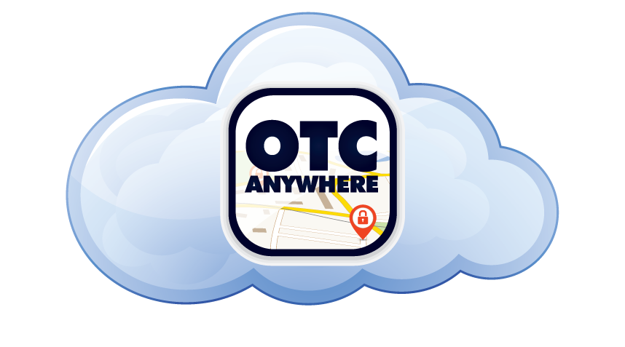
Platform | Multiple Lock Systems, Multiple Methods, Multiple Enforcements
Channels
Lock Systems
App
Primary OTC Service
Enterprise Hosted
Dedicated / Fully Isolated AWS Host(s)
Redundant Accessibility
5-Min Differential Backup
Nightly Full Backups
Offsite DR Backups
Lock System DB
Keybox
Loader / Technician
User Permission Controls
Lock System (Kaba/S&G/IG)
Lock Operating Mode (RTE/FLM)
Lock Region Access Control
Individual Lock Access Control
Time-of-Day Access Controls
Permitted Lock Functions
Geofence Open Enforcement
Geofence Close Enforcement
Open Thresholds/Auto-Lockouts
Login Methods (Phone, ID, Key)
Service Ticket Authorizations
App/Device Authorization
3rd Party
Lock System
Accessible Anywhere OTC is Deployed
Secondary OTC Service
Web
IVR
On-Premise
In-Network Appliance
Outbound Connectivity Only
Additional One-Time Purchase/Configuration
Link
Lock System
SMS
API Access
Calls from Logistics/Service Platforms
Metered Usage

Slide 3



Enterprise Lock System Hosting | Always Available, Always Safe, Always Supported Core Lock System Assets
CoorWorks Enterprise (AWS)
CoorWorks Support
Automated Monitoring/Alerting
Solution Configuration
Lock System Expertise
Last Tier Functional Support
Monitors
Internal Ops
Lock System
FW
Enterprise Hosted
Enterprise Hosted
Lock System DB
Lock System
Redundant Secondary Architecture
Redundant Keybox Authentication
Keybox
Keybox
Keybox
No Changes in Operations
Lock System Administration
Manual Dispatching
Key Management
FW
Redundant OTC Anywhere Services
Primary OTC Service
Secondary OTC Service
Service Failover
Geographically Flexible

Slide 4

Deployment Case | Companion ATM Access App
Flip Over to OTC to Open the Lock
App
App
Keys to Technician Adoption
User-Proof Simplicity
Session Length Controls (stay logged in)
Lock State Driven Interface
(what you’re able to do at this lock)
> 15 seconds to open
Walk-Away Close Enforcement
Request Volume Monitoring/Alerting
Ticket Assignment Enforcement
(with Track/Trace or Integrated App)
Ticket
App
--------
Field
App

Slide 5
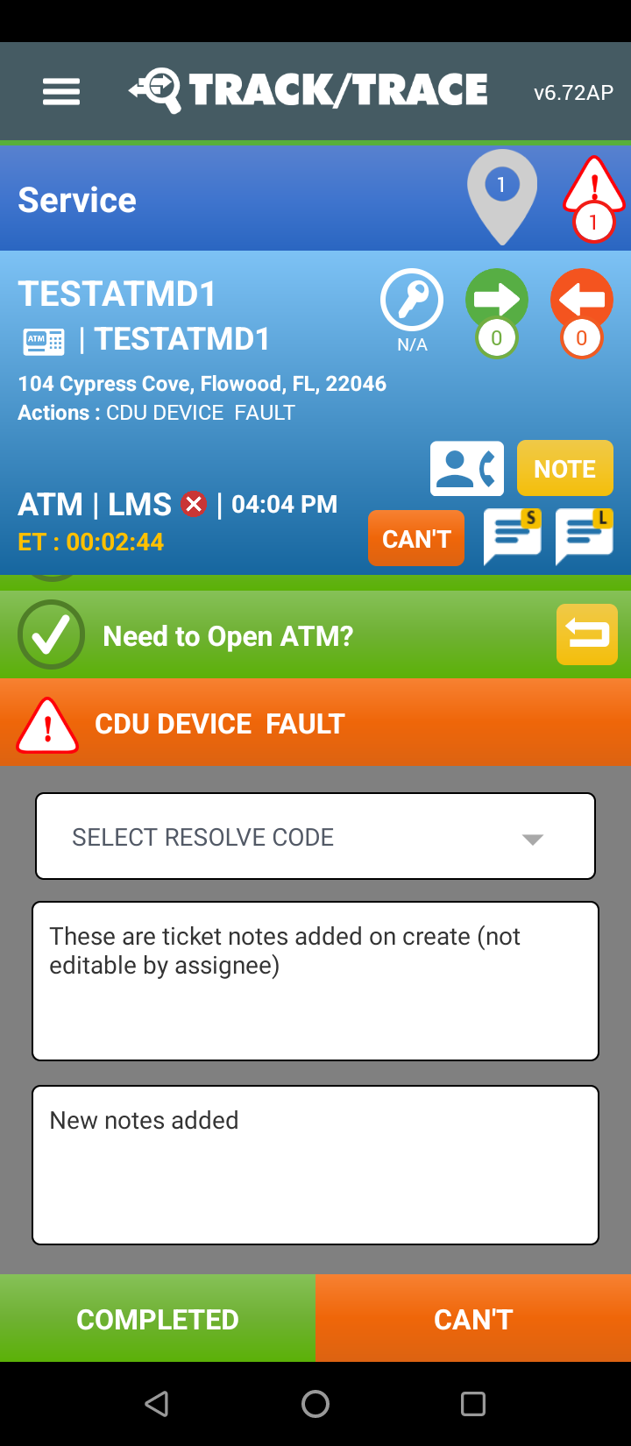

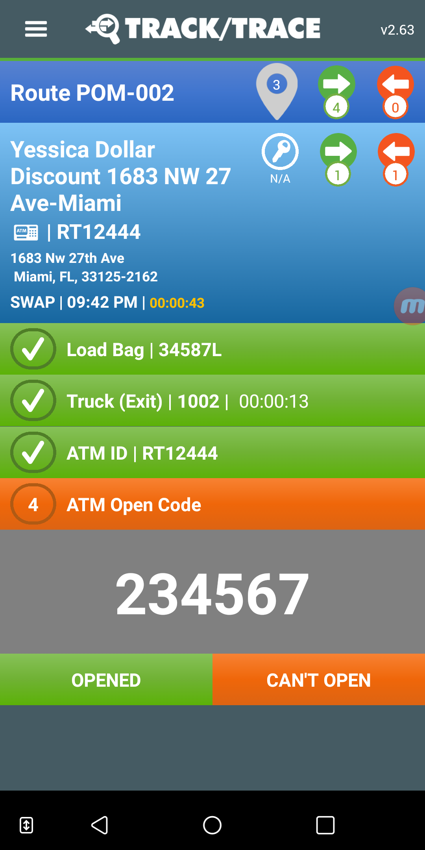
Deployment Case | Integrated with Track/Track Service
App
Visit Site
App
Request-less Automated Opening (Pulled on Service Start)
Just-In-Time Code Reveal in Service Workflows
Ticket Assignment Enforcement (no generic access)
Primary/Secondary Lock Access
Control what Services Require Openings
Schedule Demo

Slide 6
Deployment Case | Direct Internal/External App Access (API)
App
OTC Anywhere Service
CoorWorks Enterprise (AWS)
Enterprise Hosted
Lock System DB
FW
FW
Keybox
Straightforward REST API model
Dynamically Scalable API Architecture
Appropriate for Modifiable Apps
Code Delivery by SMS Options

Slide 7
Target Benefits | More Time for Growing ATM Services vs Baby-Sitting Them
Precision Access Control Design/Management
Always Available Lock Operations
Full Access History/Auditability
Manage Across Multiple Lock Systems
Real-Time Operations Monitorability
Primary/Backup Access Channels
Redeploy Dispatch Resources
Prevent Forced Lock Switching
Eliminate Off-Hours Support Coordination
Subcontractor + 3rd Party Extendable

Slide 8
{Source Images}

Slide 9
Web
App

Slide 10
App
App
Ticket
App
--------
Field
App

Slide 11
App

Slide 12
App
App

Slide 14
CoorWorks Enterprise (AWS)
CoorWorks Support
Automated Monitoring/Alerting
Solution Configuration
Lock System Expertise
Last Tier Functional Support
Monitors
Internal Ops
Enterprise Hosted
Enterprise Hosted
Lock System
FW
Lock System DB
Lock System
Redundant Secondary Architecture
Redundant Keybox Authentication
Keybox
Keybox
Keybox
No Changes in Operations
Lock System Administration
Manual Dispatching
Key Management
FW
Redundant OTC Anywhere Services
Primary OTC
Secondary OTC
Service Failover
Geographically Flexible

Slide 15
Channels
Lock Systems
App
Primary OTC Service
Enterprise Hosted
Dedicated / Fully Isolated AWS Host(s)
Redundant Accessibility
5-Min Differential Backup
Nightly Full Backups
Offsite DR Backups
Lock System DB
Keybox
Loader / Technician
User Permission Controls
Lock System (Kaba/S&G/IG)
Lock Operating Mode (RTE/FLM)
Lock Region Access Control
Individual Lock Access Control
Time-of-Day Access Controls
Permitted Lock Functions
Geofence Open Enforcement
Geofence Close Enforcement
Open Thresholds/Auto-Lockouts
Login Methods (Phone, ID, Key)
Service Ticket Authorizations
App/Device Authorization
3rd Party
Lock System
Secondary OTC Service
Accessible Anywhere OTC is Deployed
Web
IVR
On-Premise
In-Network Appliance
Outbound Connectivity Only
Additional One-Time Purchase/Configuration
Link
Lock System
SMS
API Access
Calls from Logistics/Service Platforms
Metered Usage

Slide 16
{Do Not Include Past this point}

Slide 17
Reduce Call Support
Move your lock support operation to a fully secured, self-service model and restructure your cost model
Reduce Wait Time
Eliminate all code retrieval delays and increase the stops per day your field organization can reliably deliver
Reduce Downtime
Move to an enterprise solution to increase the reliability/availability of mission-critical lock operations
Isolated Access
Provide code access to your lock system from outside your corporate network to further maximize security
Usage Restrictions
An extra layers of user restrictions based on time, lock permission, user location, lock proximity and more
Classes of Service
Define custom classes of service for users/groups to control who, what, where and why locks can be accessed
Duress Features
Introduce in-field duress signaling with multi-tiered and multi-channel alerting across your operation
Close Detection
Not only dispatch open codes but also know who left what lock open and dynamically reassign to close
Backup Channels
Set primary and backup channels for your teams to access codes no matter what situation they're in

Slide 19
Cash-in-Transit Operators
Time is money in CIT, and with the help of OTC Anywhere CIT and VIT operators can eliminate the inefficiencies of carriers waiting for access to their ATMs in either an on-demand capacity or batch opening ahead of planned routes -- all to reduce the Mean Time to Replenish and thereby increase the effective number of stops per day per team.
ATM CIT carriers request lock open access as needed (minimizing out of truck time)
OTC Batch users receive pre-populated route sheets containing the open codes they need for the day (even using existing route templates)
Automatically detect locks left open after service completion*
Introduce in-field duress reporting and alerting to maximize safety
Dynamic lock access reassignment and full lock history tracking
Location & Workflow driven code dispatching to minimize theft*

Slide 20
Deployment Case | ATM FLM/SLM Servicing
Front-Line ATM Maintenance
Drastically reduce manual dispatch support costs and expensive technician wait-times with on-demand ATM lock code access to keep your customers online and within your Service Level Agreements.
Front-Line Maintenance technicians self-serve ATM lock codes
Minimize live call support coverage to just the edge cases
Establish primary and secondary code access channels (e.g. IVR)
Introduce extra security layers to further isolate/mitigate risk
Automatically detect and reassign "not-closed" locks
Dynamically dispatch codes based on location proximity*

Slide 21
Centralized Route Dispatch Support
Even with users being able to securely self-serve lock codes, your ATM/Safe centric business still requires periodic manual lock support and supervisor lock/route reconciliation. OTC Anywhere extends beyond basic lock management functions to extend core functionality to more effectively centralize route dispatch support functions that require right now access to critical lock, key and user information -- All to trim cost and increase efficiency.
Operationally join multiple Cencon instances into a single architecture
Centralize regional support resources tied to regional Cencon instances
Maintain detailed transactional logs on all lock support cases
Allow permitted supervisors to open locks on behalf of users
Extend code access/distribution to third party carriers and vendors*
Reduce time per incident and total incident volumes

Slide 22
Cencon Lock Management Hosting
For larger operations, with regional and national ATM support footprints we provide a fully managed, professional enterprise hosting solution for your single or multiple architecture Cencon Lock Systems to ensure it's always available, fully redundant service to your support operations
End-to-end enterprise system redundancy, failover and availability
Cecon replication across multiple secured data centers (or premise locations)
Specialized support resources for lock installs, key reassigns, etc
Direct accessibility to deep Cencon management experience
Dedicated task management for any/all lock management coordination*
Cost effective alternative to coordinating with internal IT

Slide 23
Deployment Case | API Integration into Operational Apps
Service Platform or logistics app – OTC Anywhere provides full

